Slide 1
Module 1: Lesson 1 – Remote Sensing

Slide 2
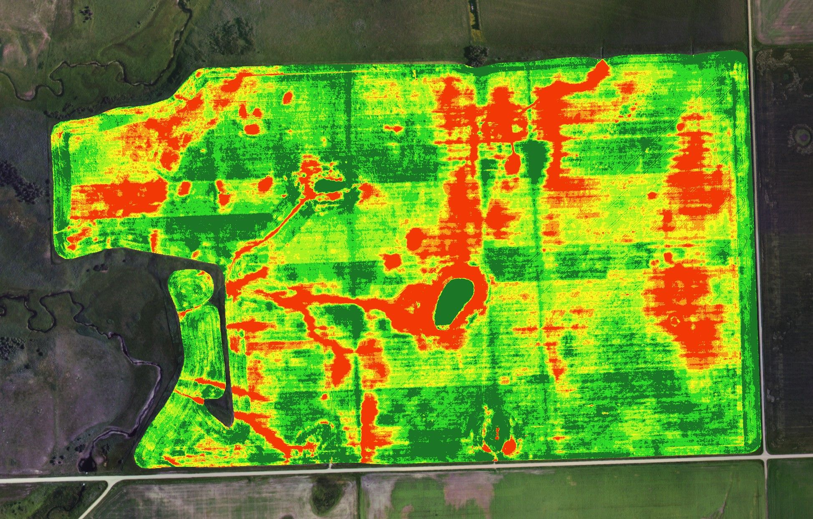
Remote Sensing Definition
Definition: The scanning of the earth by satellite or high-flying aircraft in order to obtain useful information
Examples
Severe Weather Maps
Crop Imagery
Land use mapping

Slide 3
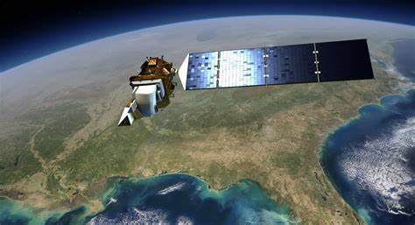
Sources of imagery – Satellite Imagery
High Altitude imagery covers large areas of land at routine intervals
Generally low cost or free
Imagery resolution can range from 3ft to 100ft per pixel

Slide 4
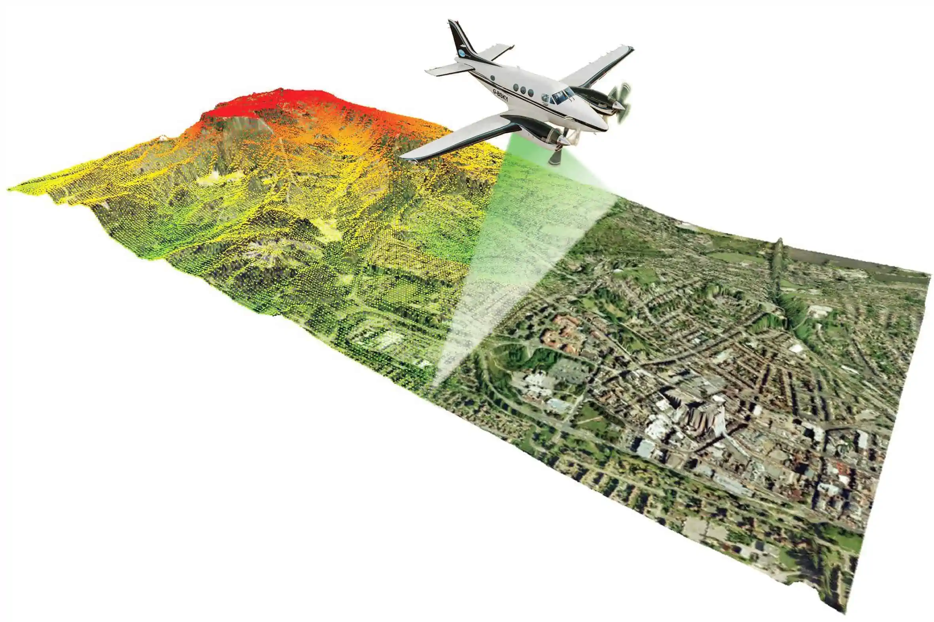
Sources of imagery – Aircraft Imagery
Low altitude imagery covers regional areas on demand
Generally a few dollars an acre
Imagery resolution can range from 1ft to 3ft per pixel

Slide 5
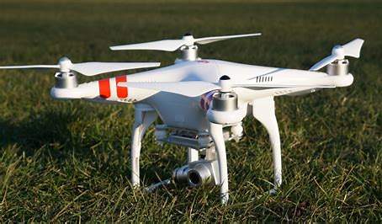
Sources of imagery – UAV Imagery
Low altitude imagery covers single fields on demand
Highest cost solution due to the time required to capture imagery
Imagery resolution can be as low as ~1in per pixel

